Slide 1
Home Electrical Safety
Safety tips for your Do-It-Yourself (DIY) electrical projects at home
Notes:
Hello. We will be discussing electrical safety while performing minor do-it-yourself work in the home. The electrical safety guidelines discussed here apply to basic electrical work in the home such as replacing an outlet, ceiling fan, or garbage disposal.

Slide 2
Electrical Safety Statistics
On average, there are 70 electrocution fatalities due to consumer products each year.
http://www.cpsc.gov/en/Research--Statistics/Electrocutions1/Electrocutions/
Approximately half of home electrical fires involve electrical distribution or lighting
http://www.nfpa.org/safety-information/for-consumers/causes/electrical/electrical-safety-in-the-home
Notes:
On average, 70 individuals die each year due to electrocution from consumer products and about half of home electrical fires involve electrical distribution or lighting.

Slide 3
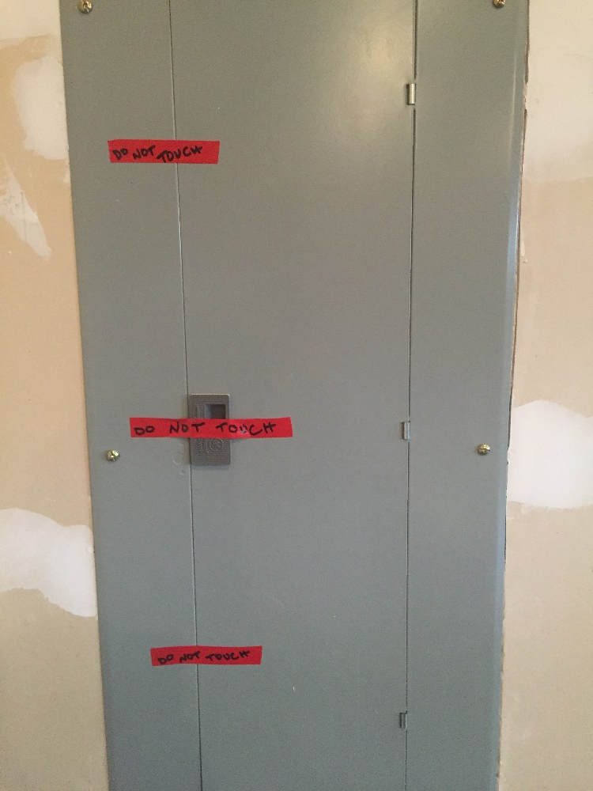
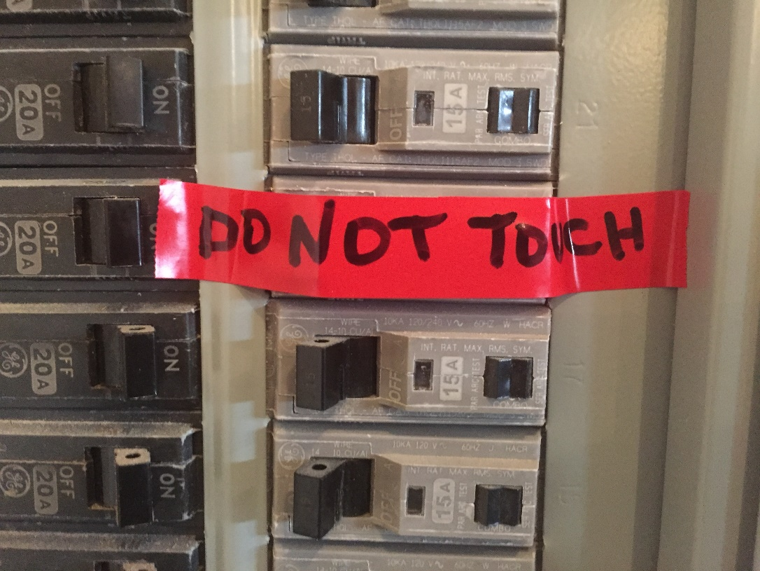
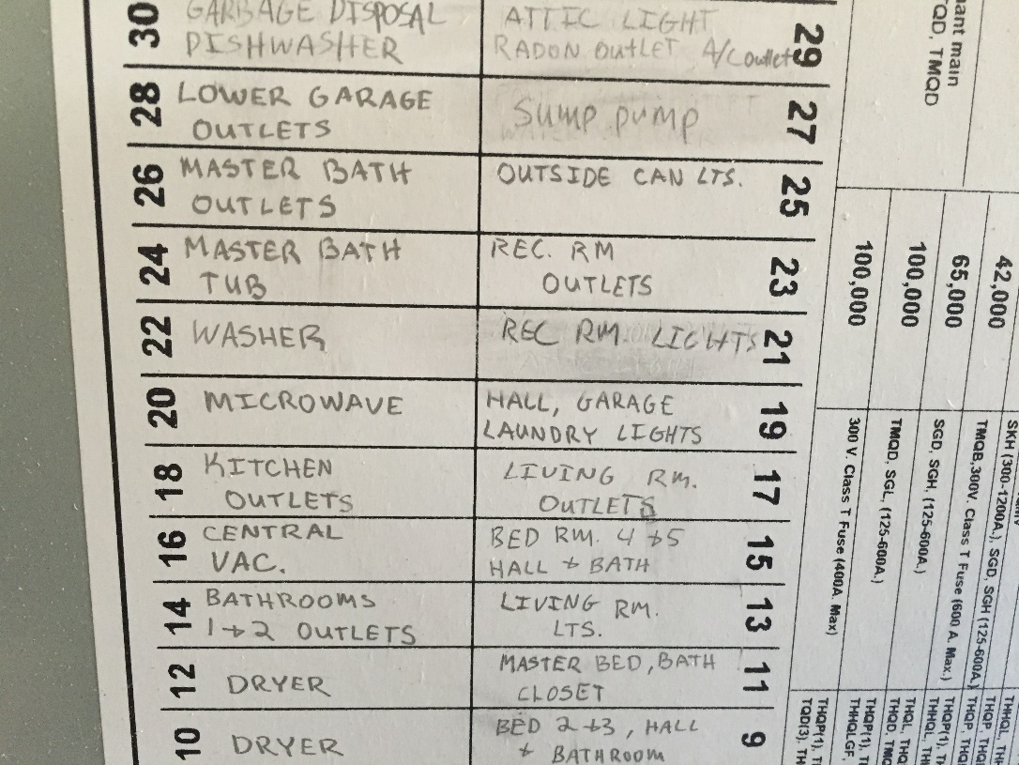
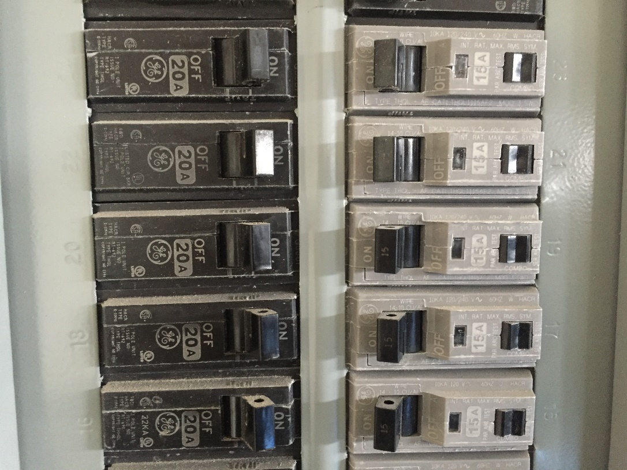
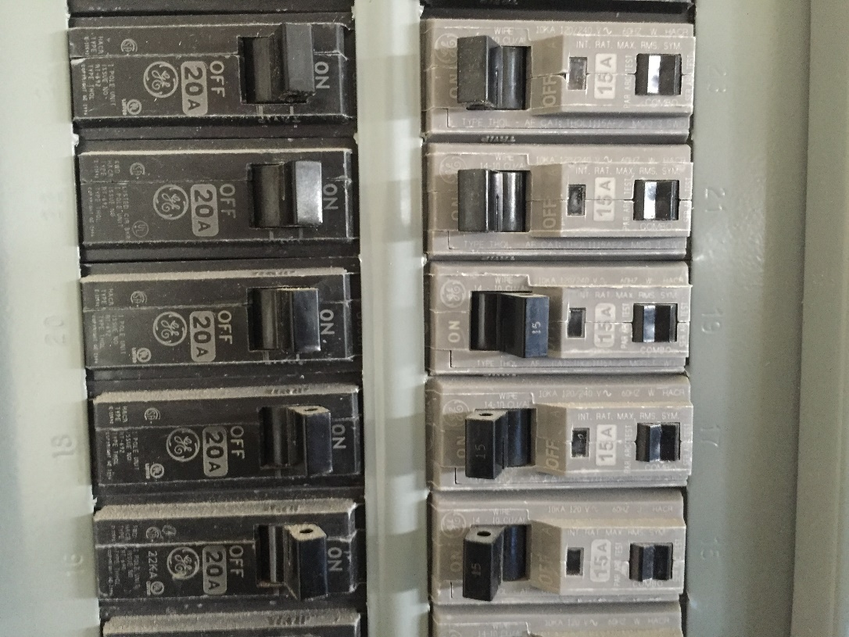
Turn off power
Turn off appropriate circuit breaker
Apply tape to the circuit breaker to ensure it isn’t turned back on
Instruct other home occupants to not turn the breaker back on
Notes:
The first step is to shut off the power to the switch. Identify the appropriate circuit breaker and flip the corresponding switch. While in an occupational setting, a lock-out tag-out procedure would be used to prevent anyone from turning the switch back on, in a household setting we can place a strip of tape over the circuit breaker and label it “Do Not Touch.” Notify all adults and older children to not touch the panel until work is complete.

Slide 4
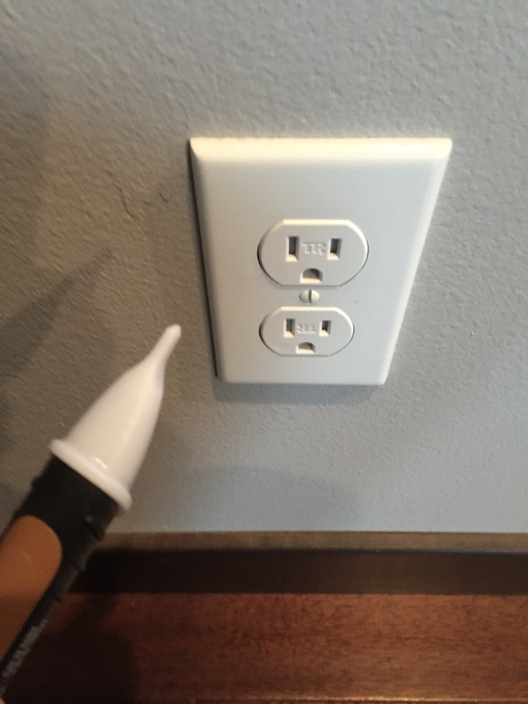
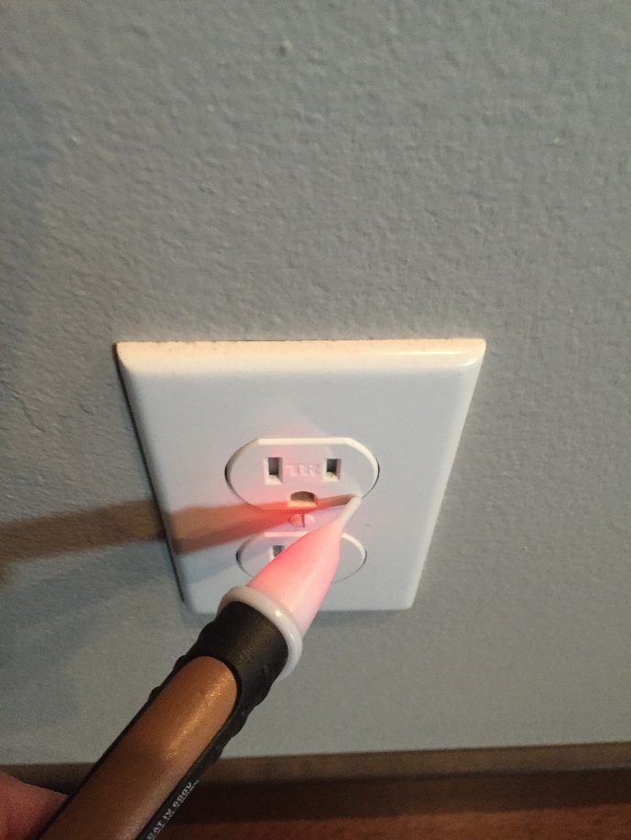
Test your voltage detector
Identify a live outlet to ensure voltage detector is operating correctly
Notes:
Next, ensure your voltage detector is working properly by testing on a live outlet. Become familiar with how your detector responds, as it may respond differently than the model shown.

Slide 5
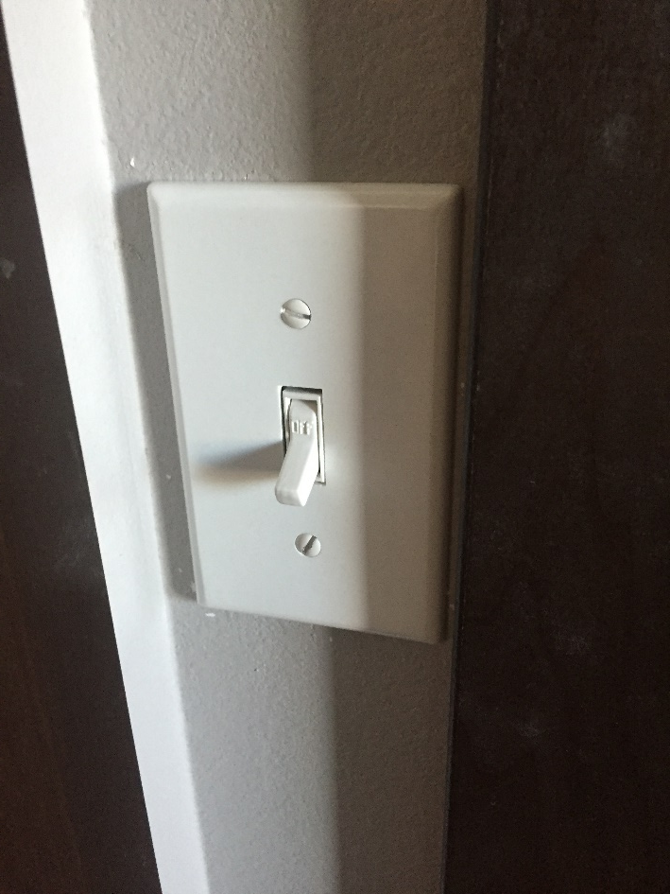
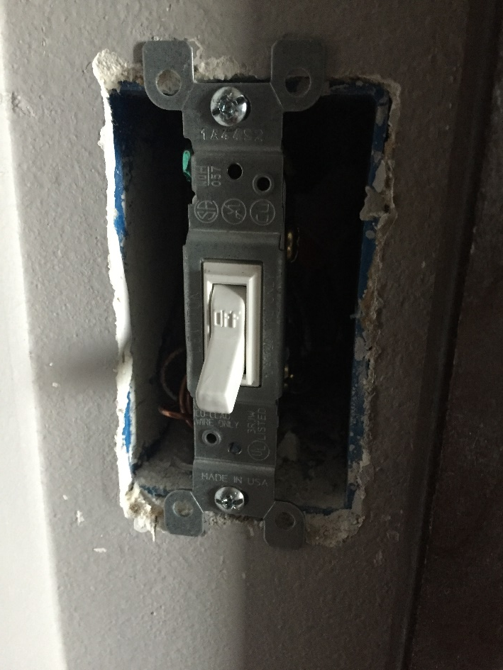
Remove the cover plate
Toggle the switch to ensure the correct circuit breaker was turned off
Remove the cover plate
Notes:
Prior to removing the switch, toggle the switch to ensure the light it controls does not illuminate. If it does, go back to the electrical panel to identify the correct circuit breaker and turn it off. If the light does not come on, it is safe to proceed and remove the cover plate

Slide 6
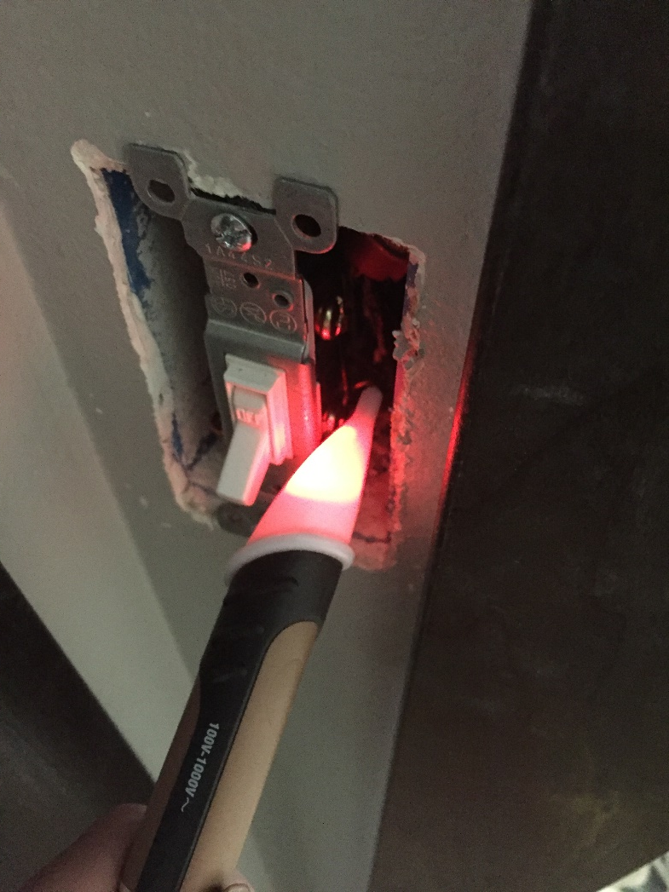
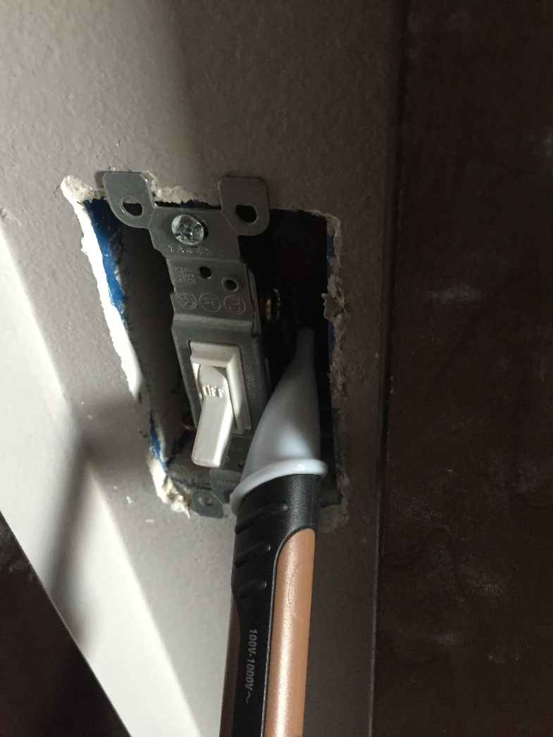
Test the power
Use voltage meter to ensure the switches in the box are not powered
Notes:
With the cover plate removed, place the voltage detector on the side of the switch with the black wires. If the detector indicates that the switch is still supplied with electricity, stop and ensure the correct circuit breaker has been turned off. If there are multiple switches, make sure to check each switch. It is possible that switches in the same electrical box are part of different circuits.

Slide 7
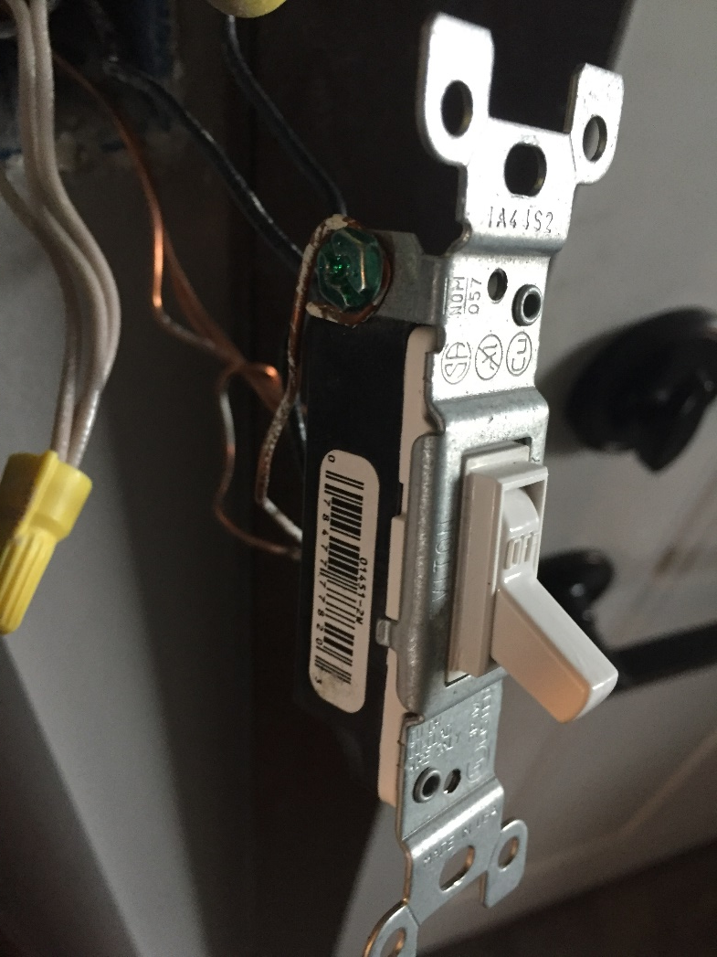
Pull switch from box
Notes:
Confident no electricity is present, remove the switch from the box. At this point, inspect the wiring connected to the switch for frayed or damaged wiring.

Slide 8
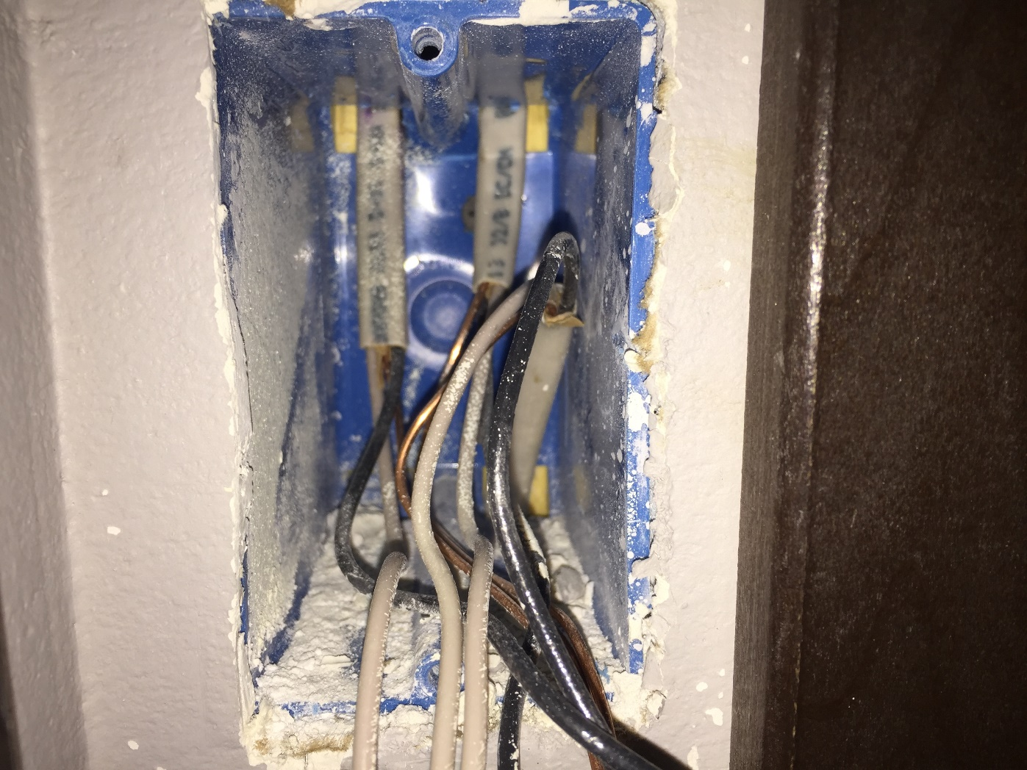
Disconnect the wires
Notes:
Disconnect the wiring from the old switch. This particular electrical box has three groups of wiring. One group comes from the electrical panel, one group travels to the light controlled by the switch, and the third group supplies electricity to a nearby electrical outlet. Each group contains three different types of wires: black wires carry electrical current from the electrical panel to the light, white wires or the neutral carry the electricity from the light back to the electrical panel, thus completing the circuit, and bare copper wires or the ground connect back to the ground at the electrical panel. Green wiring for the ground is normal.

Slide 9
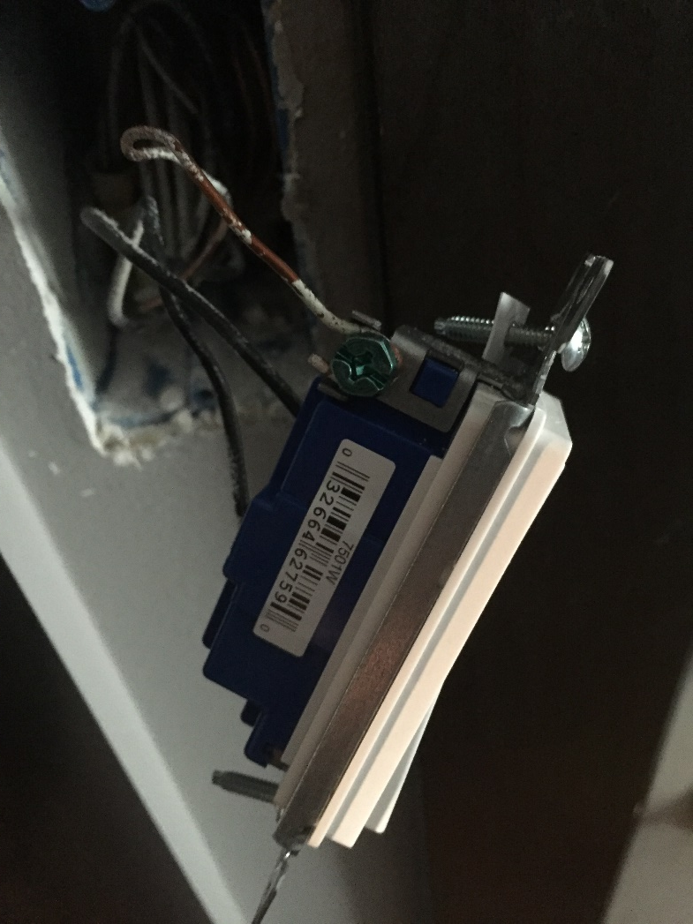
Connect new switch
Notes:
Now, connect the wires to the new switch. Connect the ground wire to the ground post. Connect the black wires to the same respective posts as the old switch. Ensure that a minimal amount of the black wiring is exposed to prevent it from coming into contact with the ground wire.

Slide 10
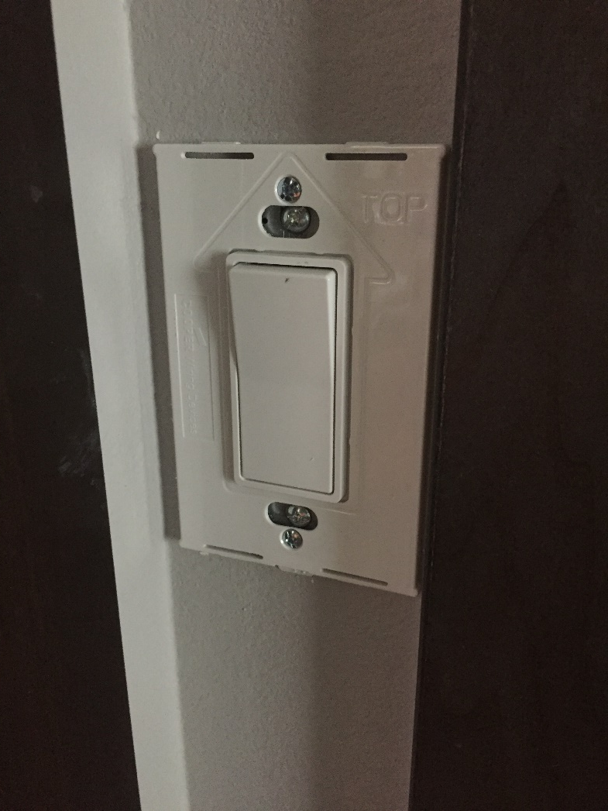
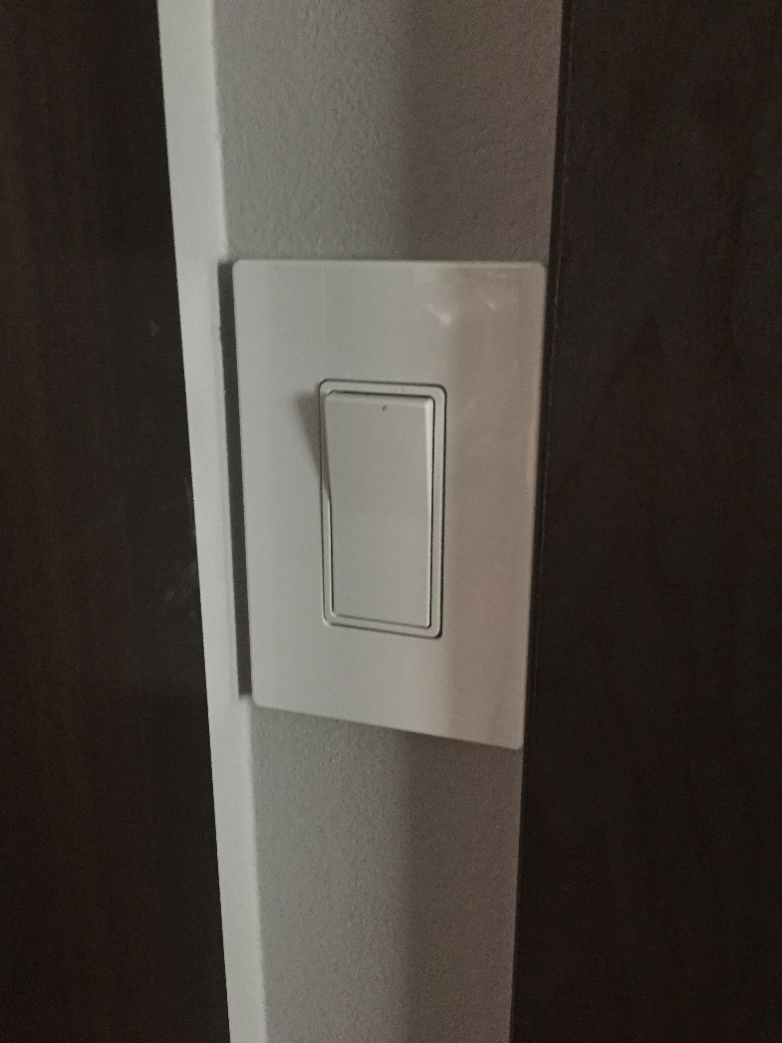
Complete install
Notes:
Install the switch into the electrical box. Turn on the power and test the new switch. If the light does not turn on, turn the power back off and check to ensure all of the wires are properly connected. Don’t forget to use your voltage detector again to ensure the switch is not energized.

Slide 11
Other safety items
Use a fiberglass ladder for electrical work that can’t be performed at ground level such as installing a ceiling fan
Do not work with electricity in wet locations
If you feel uncomfortable at any point working with electricity, contact a licensed electrician for help
Notes:
Other important items to note are to always use a fiberglass ladder for electrical work and to never work with electricity in wet locations. If you feel uncomfortable working with electricity, don’t hesitate to contact a licensed electrician.

Slide 12
Home Electrical Safety
Prepared by: Craig Holder
Prepared for: OEH:5410 Occupational Safety
At The University of Iowa, College of Public Health

