Slide 1
Lawn Mower Safety
Erin Morley

Slide 2
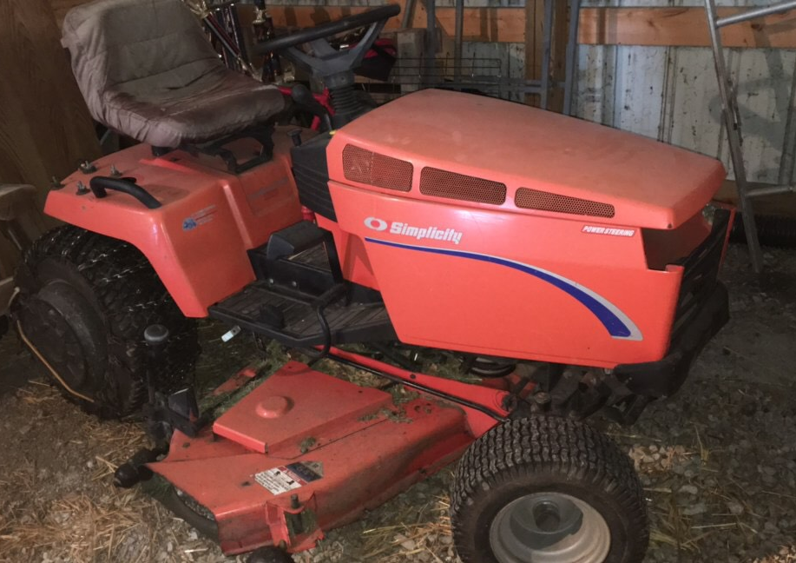
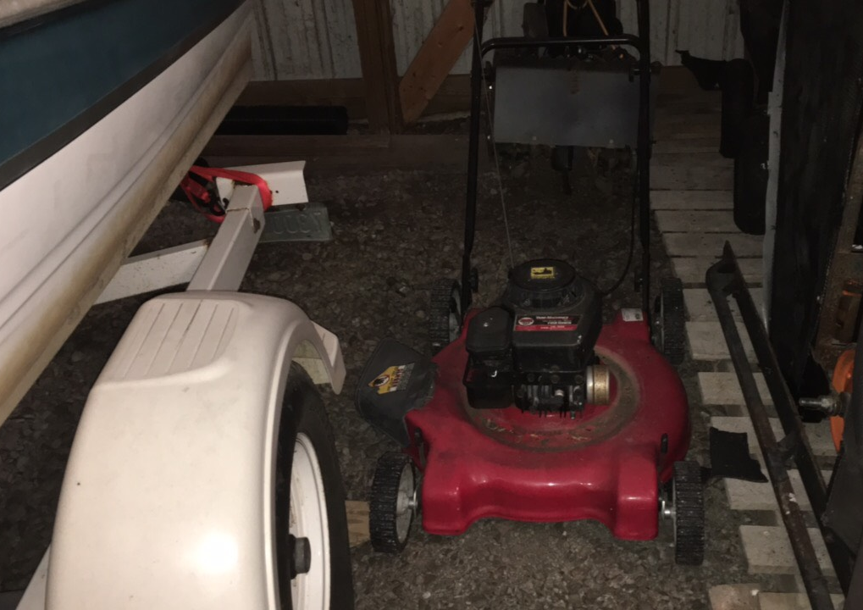
Is it a problem?
U.S. Consumer Product Safety Commission’s (CPSC) National Electronic Injury Surveillance System (NEISS) reports that in 2015:
An estimated 81,938 injuries from lawn mowers
71,843 people are treated and released
10,096 people were hospitalized or dead on arrival (DOA)
Most injuries occur to people 25-64 years old
Most injuries occur to males (62,138 injuries) compared to women (19,801 injuries)

Slide 3
Precautions-General
Personal Protective Equipment (PPE)
Safety glasses should always be worn when operating equipment
Face shields can also be worn to protect the face from debris
Hearing Protection
Wear ear muffs or ear plugs should be used while operating machinery to prevent hearing loss

Slide 4
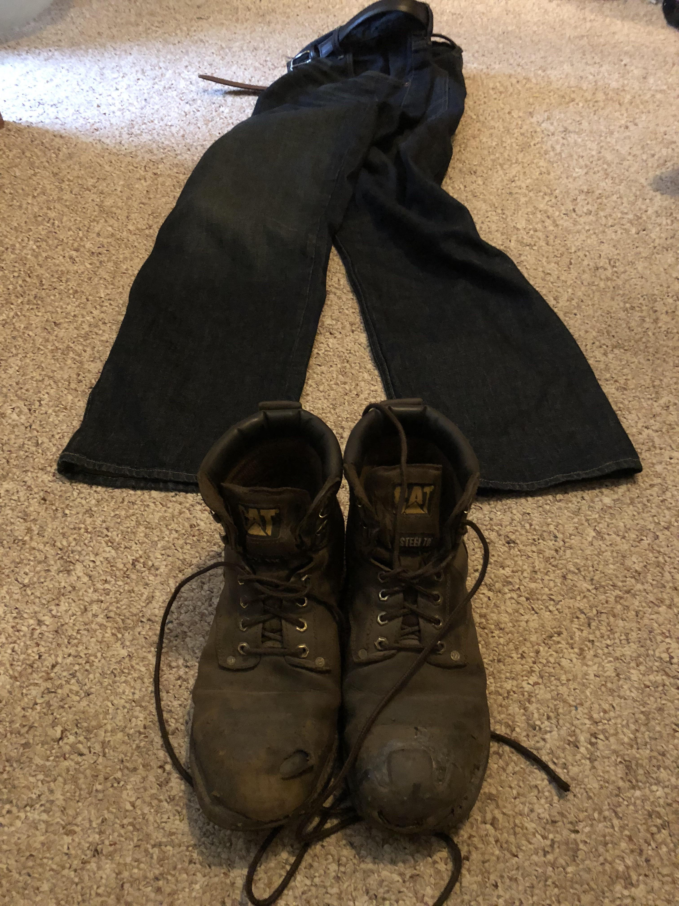
Precautions-general
PPE
Clothing
Should be tight fitting so they don’t get caught up in moving parts
Long pants and sturdy, closed-toed shoes will help prevent abrasions to the legs from flying debris and protect feet from mower parts
Prepare Mowing Area
Clear any large debris from area (sticks, large rocks etc.)
Take note of any hazards
Ditches, drop-offs etc
Other people walking around the area
Make sure mower chute is pointed away from buildings, people, animals or traffic

Slide 5
Start up/shut down
Start up
Disengage all attachments
Shift into neutral before starting the engine
Riding Mower: only start equipment from the operator seat
Walk Behind Mower: keep hands and feet away from blade when starting
Shut Down
Disengage blade and other attachments
Lower attachments to ground
Shift controls to neutral
Set parking brake
Turn off engine
Remove key (if applicable)

Slide 6
Roll over incidents
When a lawn mower looses balance on a slope it can tip over and crush the operator
Do not mow near drop-offs, steep slopes, large ditches, or steep hills
Refer to the operating manual for slope limitations of the equipment
Riding Mower: Mow up and down hills not across to avoid tipping
Walk Behind Mower: Mow across hills, not up and down to avoid sliding under the mower

Slide 7
Caught in moving parts
Make sure all guards are in place on mower
Never add a blade or chain to a mower that is not approved by the manufacturer
Shut off mower engine before picking up debris or performing any maintenance on mower
Riding Mower: Keep all hands and feet inside equipment at all times
Walk Behind Mower: always push the mower, never pull, to avoid pulling mower over feet

Slide 8
References
https://www.cpsc.gov/Research--Statistics/NEISS-Injury-Data
https://www.cpsc.gov/s3fs-public/2015%20Neiss%20data%20highlights.pdf
https://www.osha.gov/dte/grant_materials/fy09/sh-19503-09/mowing-trimming_safety_manual.pdf
Actor: Alex Morley
eye/hearing PPE

Slide 9
“Lawn Mower Safety”
Prepared by: Erin Morley
Prepared for: OEH:5410 Occupational Safety
At The University of Iowa, College of Public Health

